Slide 1
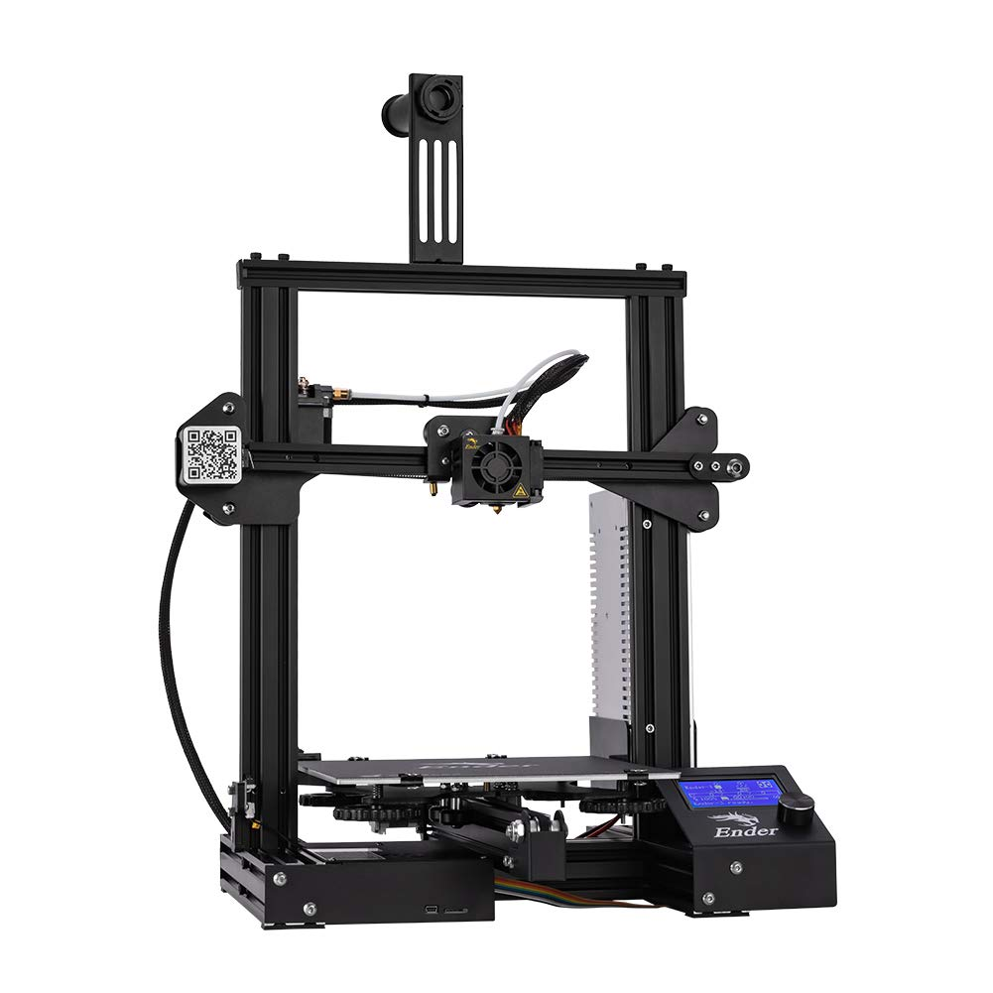

Team 21: 3D Printer and Application Interface
Bi-Weekly Update 3 Cody Hutchison Steven Liu Abigail Morar Sponsor: Dalton Cyr TA: Milenka Gamero
Notes:
Michelle

Slide 2
Project Summary
Current 3D printers require the user to manually upload a G-code file by an external storage device and initiate the printing process via controls on the printer
The new 3D printer and Application will allow the uploading, controlling, and initiation of printing from anywhere with internet access. The print time will also be within 10% of the Ender 3 printing time while also attempting to speed up the Z-axis movement speed.
Notes:
Kyle

Slide 3
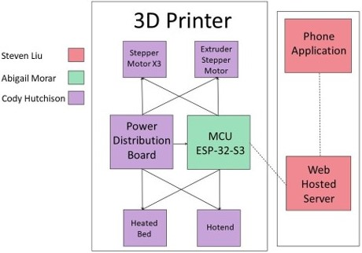
Project/Subsystem Overview
Notes:
Eric

Slide 4
Project Changes for 404
Everything is still on track from what was planned in 403.
As of now, changes are mostly geared towards fixing bugs in the current subsystems, preparing for full integration, and dealing with whatever problems may arise from that.
Notes:
Eric

Slide 5
Project Timeline
Validate System
Finish Subsystems
Integrate Subsystems
Final Presentation
Final Demo
February 15
March 15
March 29
April 10
April 24
Notes:
January 30th - February 5th
Ensure all parts required to complete PCBs are on hand or order more
Start populating PCB if they have arrived
February 6th - 12th
Have PCB populated and validate

Slide 6
Electrical Subsystem
Cody Hutchison
Accomplishments since last update 22 hrs of effort | Ongoing progress/problems and plans until the next presentation
- Validated Main Controller PCB - Validated Axis Driver PCB | Integrate PCB with MCU Design printer mount for PCBs

Slide 7
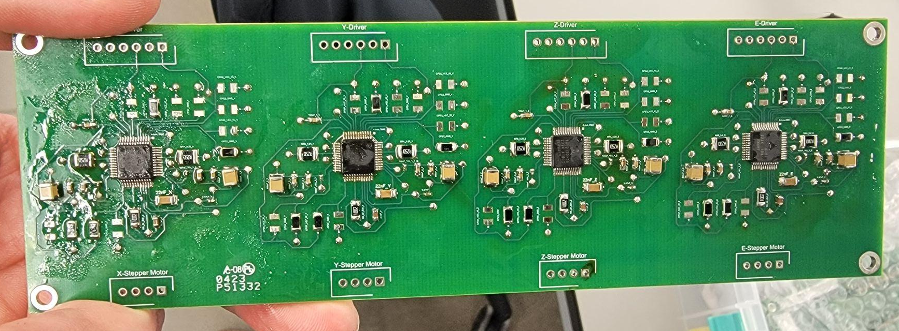
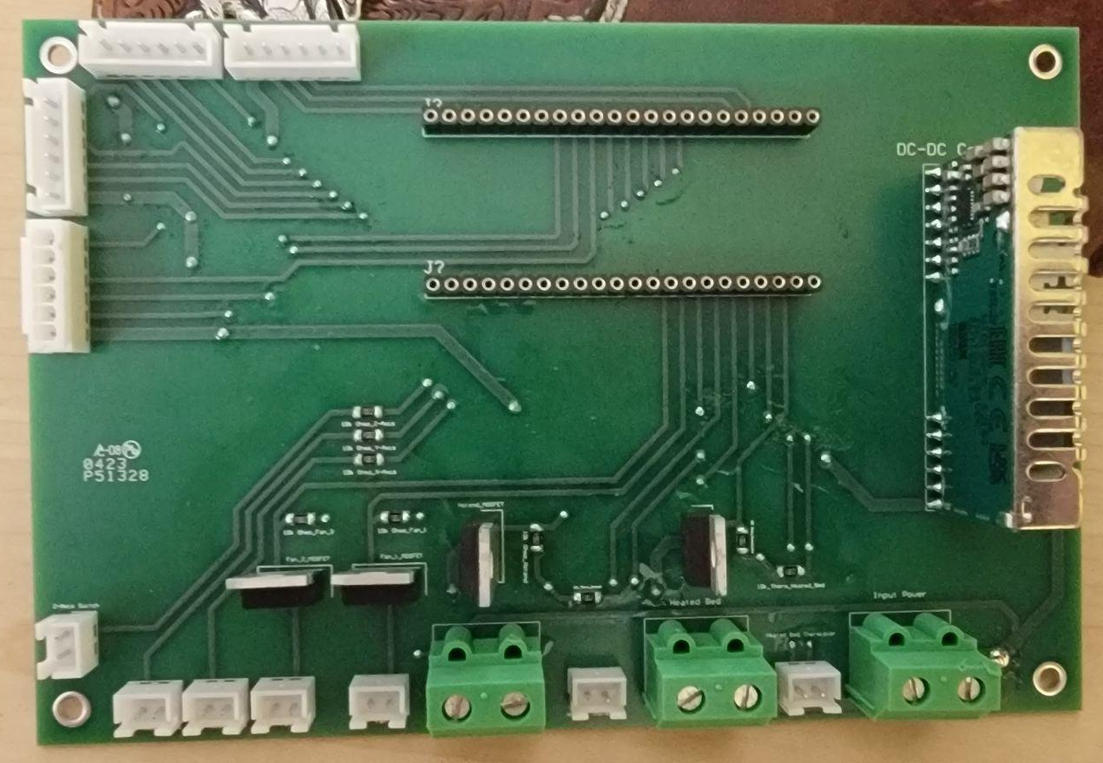
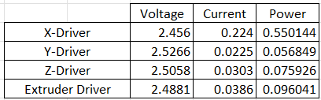
Electrical Subsystem
Cody Hutchison

Slide 8
Application and Server Subsystem
Steven Liu
Accomplishments since last update 10 hrs of effort | Ongoing progress/problems and plans until the next presentation
Fixed url firebase communication bug Fixed in-app fragment communication bugs | Add a print completion notification to user Make a new demo recording using app from physical device Look for other possible bugs or UI improvements

Slide 9
Application and Server Subsystem
Steven Liu

Slide 10
Microcontroller Programming Subsystem
Abigail Morar
Accomplishments since last update 11 hrs of effort | Ongoing progress/problems and plans until the next presentation
- Completed integration with Firebase | - Will begin testing functionality of stepper motors and integrate with PCB

Slide 11
Integration
Accomplishments since last update | Ongoing progress/problems and plans until the next presentation
App/Server and MCU subsystems integrated | Validate App/Server and MCU integration Begin integration between MCU and Electrical Subsystem

Slide 12
Parts Ordering Status
3 TMC-2130 Driver Controller were ordered and received
Notes:
Michelle

Slide 13
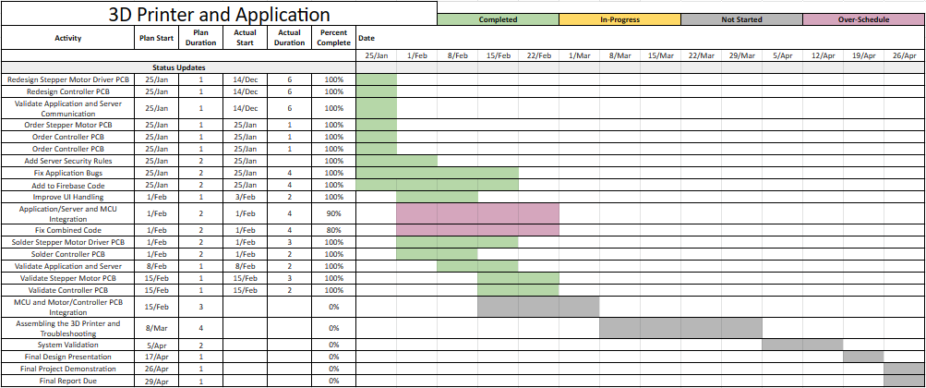
Execution Plan
Notes:
Michelle

Slide 14
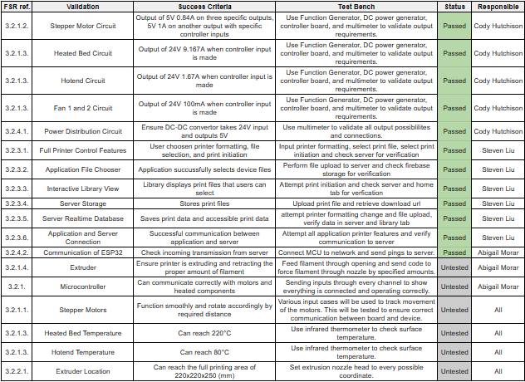
Validation Plan
Notes:
Michelle

Slide 15
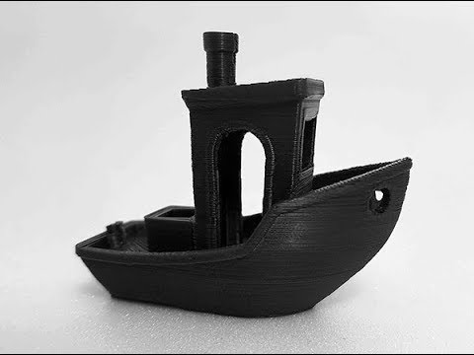
Questions? Comments?
Thank You

